Slide 1
8253 / 8254 Timer
PIT (programmable Interval Timer), used to bring down the frequency to the desired level
Three counters inside 8253/8254. Each works independently and is programmed separately to divide the input frequency by a number from 1 to 65536
There are 4 port address needed for a single 8253/8254, given by A0, A1, and CS CS A1 A0 Select
  0 0 0 Counter 0
  0 0 1 Counter 1
  0 1 0 Counter 2 0 1 1 Control Reg.

Slide 2
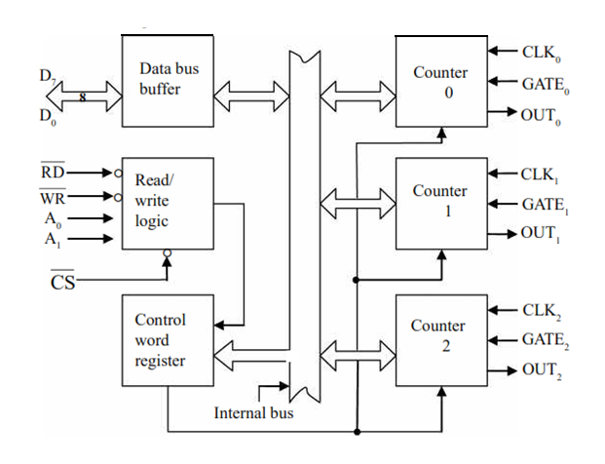

Engr 4862 Microprocessors

Slide 3
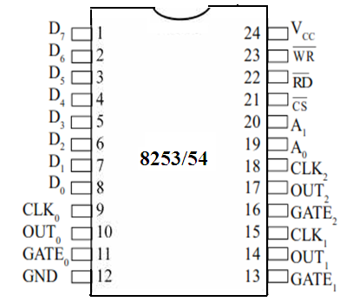
Engr 4862 Microprocessors

Slide 4
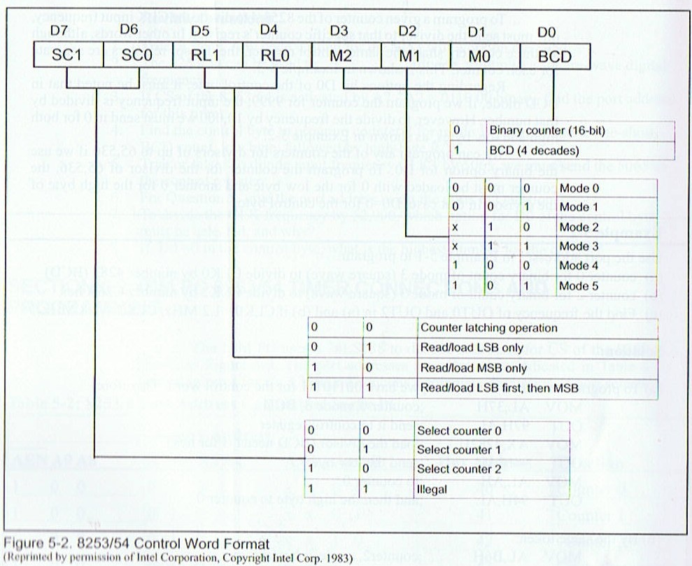
8253 / 8254 Timer
Engr 4862 Microprocessors

Slide 5
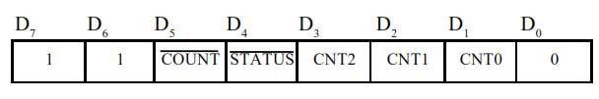
Engr 4862 Microprocessors

Slide 6
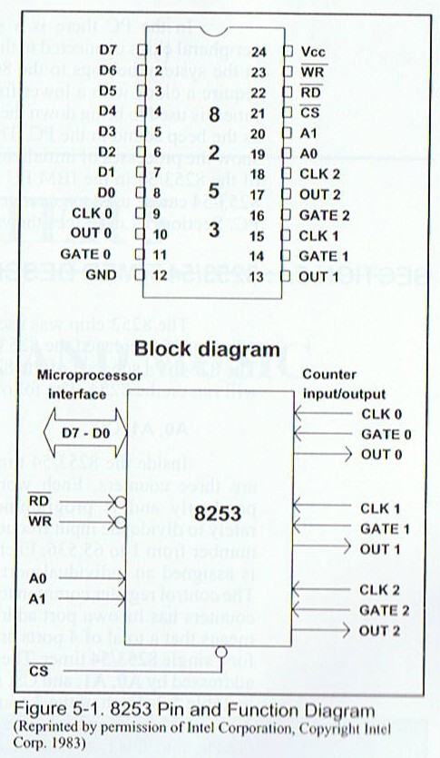
8253 / 8254 Timer
Engr 4862 Microprocessors

Slide 7
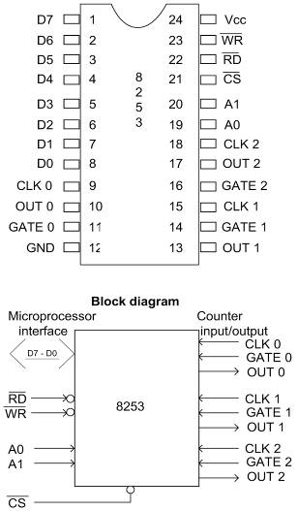
8253/54 TIMER
8253/54 must be initialized
before it is used
Each of the three counters must be programmed separately.
The control byte must first be written
into the control register.

Slide 8
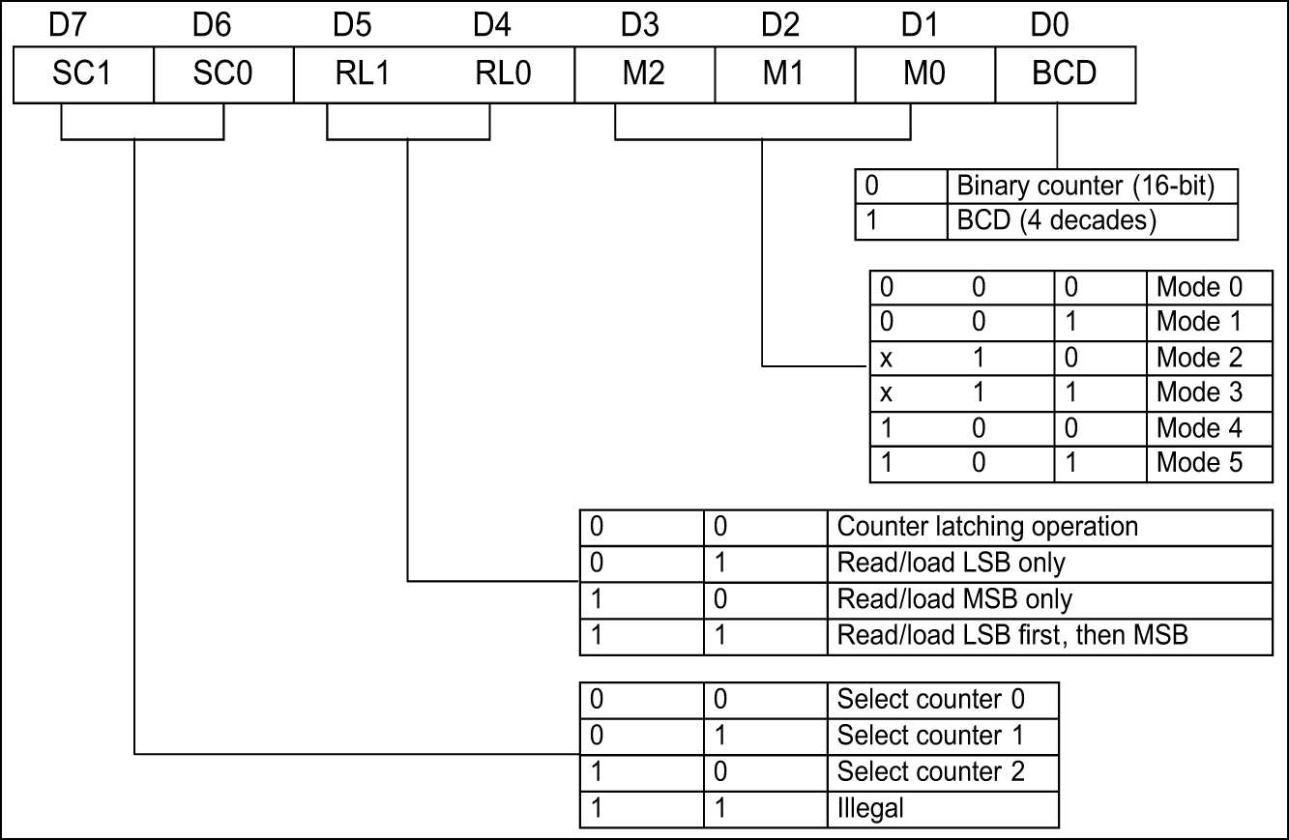
8253/54 TIMER control word
The one-byte control word of the 8253/54, sent
to the control register, has the following bits:
D0 chooses between a
binary number divisor
of 0000 to FFFFH or
a BCD divisor of
0000 to 9999H.

Slide 9
8253/54 TIMER control word
The one-byte control word of the 8253/54, sent
to the control register, has the following bits:
D1, D2, and D3 are
for mode selection.
Six possible modes
determine output
signal shape.
Mode 0 Interrupt on terminal count.
Mode 1 Hardware-triggered one shot.
Mode 2 Rate generator.
Mode 3 Square wave rate generator.
Mode 4 Software triggered strobe.
Mode 5 Hardware triggered strobe.

Slide 10
8253/54 TIMER control word
The one-byte control word of the 8253/54, sent
to the control register, has the following bits:
D4 & D5 are for
RL0 & RL1 - to
indicate size of the
input frequency
divisor, with 3 options:
  Read/write the most significant byte (MSB) only.
  Read/write the least significant byte (LSB) only
  Read/write LSB first, followed immediately by MSB

Slide 11
8253/54 TIMER control word
The one-byte control word of the 8253/54, sent
to the control register, has the following bits:
D6 & D7 are used to
select which of the
three counters is to
be initialized by the
control byte, 0, 1, 2.
To program a given counter to divide the CLK input frequency, send the divisor to that specific counter's register.

Slide 12
Thanks
Engr 4862 Microprocessors

